Slide 1


Support Meaningful
Access to Justice
Presented by Bennett Root | Executive Director
Mediation Center of Los Angeles
Notes:
Thank the Board for the invitation. Tonight I want to talk with you about a working partnership between Bet Tzedek and MCLA — what we have already built together, and the next step Diego and I believe we are ready to take.

Slide 2

This Photo by Unknown Author is licensed under CC BY
THE CONVERSATION
Why I Am Here Tonight
1
A working partnership.
MCLA and Bet Tzedek already have shared efforts to expand access to justice. This proposal builds on that foundation with a more intentional and sustainable partnership.
2
Shared objectives.
We share significant alignments: reducing barriers to justice, supporting underserved communities, and helping people navigate difficult legal problems. Bet Tzedek provides the legal advocacy; MCLA provides neutral dispute resolution.
3
A concrete next step.
Giving Bet Tzedek attorneys another resource for appropriate cases.
A cooperative ADR program would give Bet Tzedek attorneys direct access to prepaid mediation and arbitration services when early resolution could benefit a client.
“When mediation helps resolve an appropriate case sooner, Bet Tzedek gains something equally valuable: attorney capacity to serve the next client.”
Notes:
Frame the evening. Keep it short — the Board will want to get to the ask. Signal early that this is a partnership proposal, not a solicitation for a donation to MCLA.

Slide 3
INTRODUCTION
Who Is MCLA?
501(c)(3) nonprofit
Official LASC Referral Resource
Providing affordable ADR services across Los Angeles County for more than a decade.
A trusted partner of the Superior Court of Los Angeles County.
Nearly 50 Mediators
Substantially Reduced-Rates
Seasoned, full-time professional neutrals — all trained and experienced in finding acceptable solutions for disputants.
Our mediators substantially discount private rates to put early case resolution within reach for all Angelenos.
Notes:
Establish credibility before the ask. The court relationship is the single most persuasive credential for this audience — it tells them our neutrals are vetted by an institution they respect.

Slide 4
SCALE
MCLA by the Numbers
5,000
48
$600
civil unlimited, probate
and family law matters
referred to MCLA this year
full-time professional
mediators on panel
per party
For a 2-party, 3 hour
civil unlimited mediation
Every matter resolved is a matter removed from a judicial docket — saving the court millions in taxpayer funds.
Notes:
Confirm the mediator count and the current-year case projection before delivery. The taxpayer-savings point lands well with board members who have public-sector or civic backgrounds.

Slide 5
RESULTS
What Mediation Actually Delivers
75%
of cases that reach our mediators produce a result that moves the matter forward — either full early resolution or a materially better posture for the client.
Source: MCLA program data. Figures are approximate and should be refreshed against current-year reporting.
Notes:
The point for this Board is not the settlement rate on its own. It is that three out of four mediated matters come back to the legal team in better shape than they went in — which is what frees supervising attorney time.

Slide 6
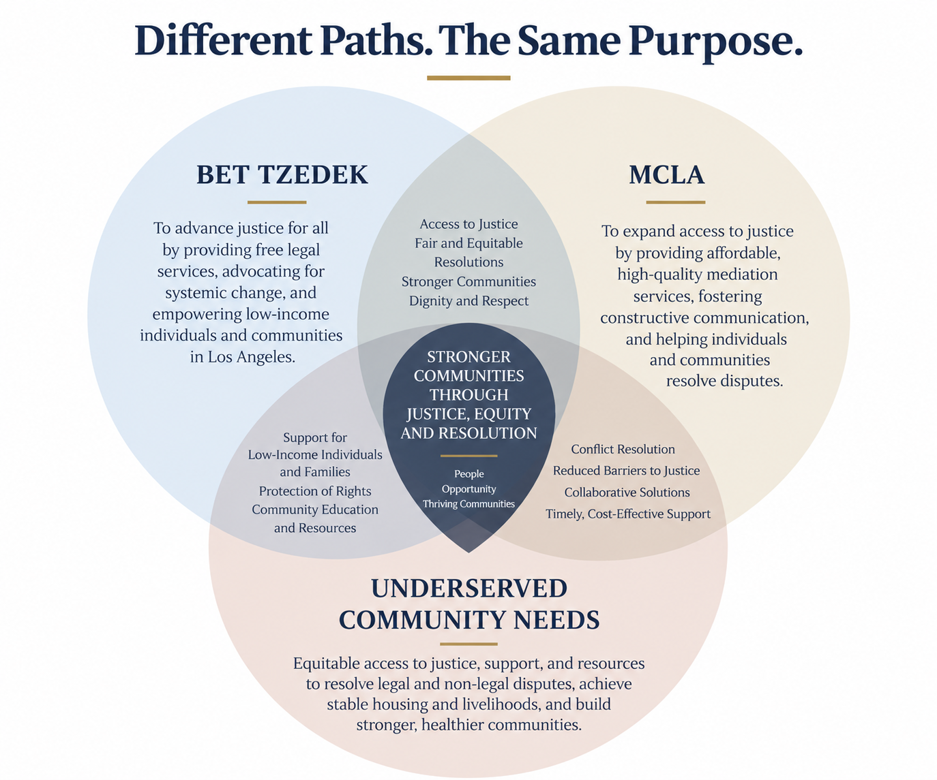
SHARED MISSION
Shared Objective.
Notes:
Replace the summary lines with the verbatim text of both mission statements before delivery — reading Bet Tzedek their own words is far more effective than paraphrasing them.

Slide 7
WHY THIS WORKS
The Idea Is Simple
1
2
3
→
Earlier resolution preserves legal capacity
→
Bet Tzedek serves more clients
Mediation creates an opportunity for earlier resolution
Appropriate matters may be resolved through mediation without requiring the time and resources associated with continuing litigation.
Every case closed early returns supervising and managing attorney hours to the legal team.
Recovered capacity allows the same legal team to assist more individuals and families who need access to legal services.
More matters resolved. More capacity available. More people reached.
By adding affordable ADR to Bet Tzedek’s existing resources, we can help extend the impact of the legal services already being provided.
Notes:
This is the hinge of the presentation. Slow down here. The Board needs to accept the capacity argument before the funding ask makes sense to them.

Slide 8
PROGRESS TO DATE
We Have Already Made a Start
COMPLETE
Advanced mediation advocacy training
MCLA developed and presented an advanced mediation training to Bet Tzedek attorneys, giving the legal team additional tools to identify appropriate matters, prepare clients, and advocate effectively in mediation.
PROPOSED
Put That Training Into Practice
The next step is to give Bet Tzedek attorneys a practical way to use ADR when an appropriate case arises. A prepaid ADR resource would remove the cost barrier and allow supervising attorneys to consider mediation based on the needs of the case.
The training is in place. The next step is access.
Notes:
Credit Diego by name here. The Board should hear that this proposal originated jointly and not as an outside pitch.

Slide 9
THE PROPOSAL
The ADR Access-to-Justice Package
Board-Supported Funding
ONE PACKAGE
Each package is sponsored by a law firm represented on Bet Tzedek’s Board, using the firm’s charitable giving budget rather than Bet Tzedek’s operating funds.
5
mediations
What it covers
1
The package covers Bet Tzedek’s share of the already-reduced mediation cost. The opposing party remains responsible for its share.
arbitration
How Cases Are Selected
Funded by a participating Bet Tzedek Board law firm and administered by Bet Tzedek’s legal team.
Bet Tzedek’s legal supervisors determine when to use the package, prioritizing matters where mediation can meaningfully reduce case duration, conserve legal resources, and advance resolution for the client.
No existing Bet Tzedek program funds are redirected. Each $7,500 package represents new, purpose-specific support for client dispute resolution.
Notes:
Expect the first board question here: does this compete with our annual appeal? Answer directly — it is a defined, nameable gift with a measurable output, which most development directors find easier to sell, not harder.

Slide 10
THE OPPORTUNITY
What Bet Tzedek’s Support Makes Possible
FASTER PATH TO RESOLUTION
1
Appropriate cases can move from prolonged litigation toward resolution through a focused mediation process, giving clients an earlier opportunity for closure.
MORE CAPACITY TO SERVE
2
Each package supports 5 mediations and 1 arbitration, helping Bet Tzedek resolve suitable matters more efficiently and preserve attorney time for clients who need continued legal representation.
REMOVES A COST BARRIER
3
Pre-funded ADR gives Bet Tzedek attorneys another option when mediation makes sense but cost could otherwise prevent the case from moving forward.
Bet Tzedek handles housing, employment, tax, small business, senior and dependent adult, children and caregiver, and transgender rights matters — all free of charge to the client.

Slide 11
WHAT IT INCLUDES
The Cooperative Program
Annual Advanced Training
1
Annual CLE-approved advanced mediation advocacy training for Bet Tzedek’s legal staff, strengthening mediation skills across the organization.
Prepaid ADR Access
2
Program-wide ADR credits give Bet Tzedek attorneys access to MCLA mediation and arbitration services when appropriate, without limiting participation to a small pilot group.
Independent Neutrality
3
MCLA mediators remain independent neutrals. Participation in the program does not influence mediator selection, case assignments, or a mediator’s ability to serve in other matters.
The third point matters to your risk counsel: a partnership on program design does not compromise the independence of any neutral in any individual case.
Notes:
The independence point is the one a board with practicing lawyers on it will probe. Be ready to explain that neutral selection in any given matter remains entirely at arm’s length.

Slide 12
THE ASK
15–20 Packages for This Board
6
15–20
100
ADR sessions per package
(5 mediations + 1 arbitration)
ADR Access-to-Justice
packages purchased
across the Board
Projected mediation cases in progress
at peak initiative
Dedicated ADR capacity — up to 100 projected cases appropriate for mediation and streamlined to resolution.
Figures assume 15–20 packages at $7,500 each; confirm the final target range with MCLA leadership before delivery.
Notes:
Land the anniversary framing here — fifty packages is a number the Board can picture and a number individual supporters can claim a share of.

Slide 13
Together, we can help more clients reach resolution sooner.
Your support expands Bet Tzedek’s capacity and makes professional dispute resolution accessible to more Angelenos.
Presented by Bennett Root | Executive Director
Mediation Center of Los Angeles
Ben@MediationLA.org | (626) 389-5006
Thank you. We welcome your questions.
Notes:
Close on the win-win, not on the number. Invite Diego to join for questions if he is present.

